Slide 1

SAFMC 2024
Final Presentation | CAT E | Team DOTA7, NYP
Team DOTA7, NYP
1

Slide 2
Introduction
01
The Team
Team DOTA7, NYP
2

Slide 3


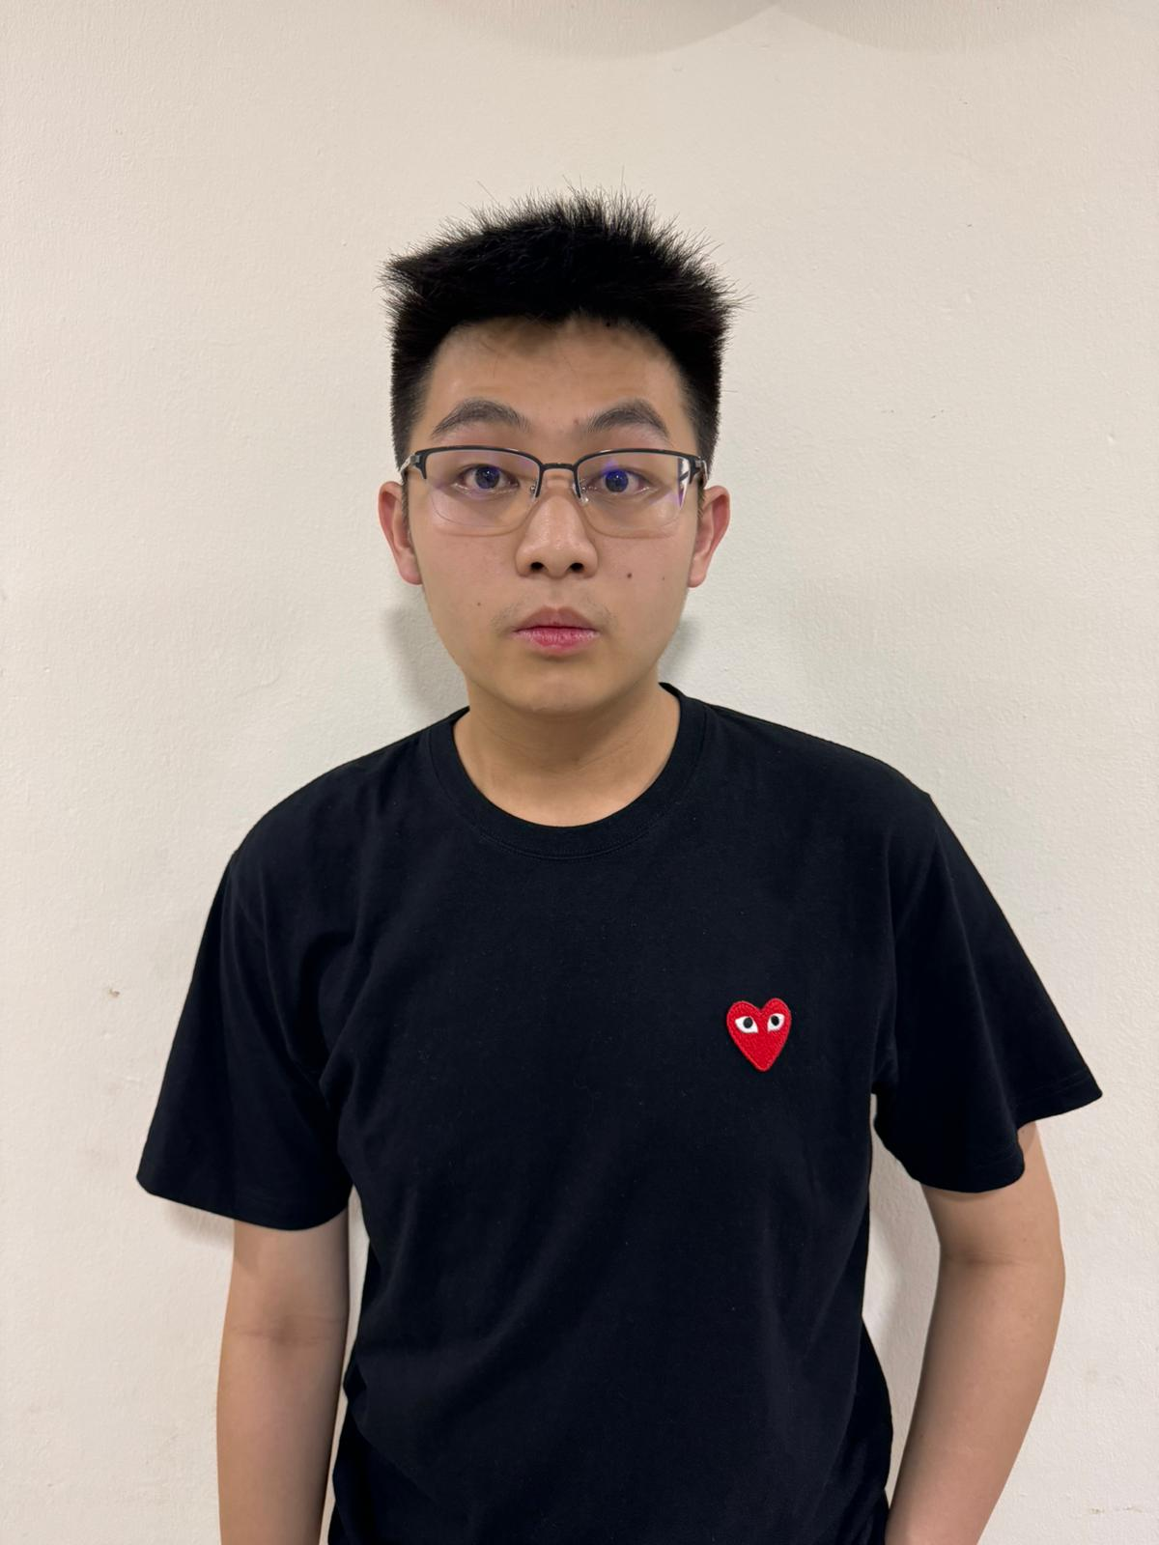




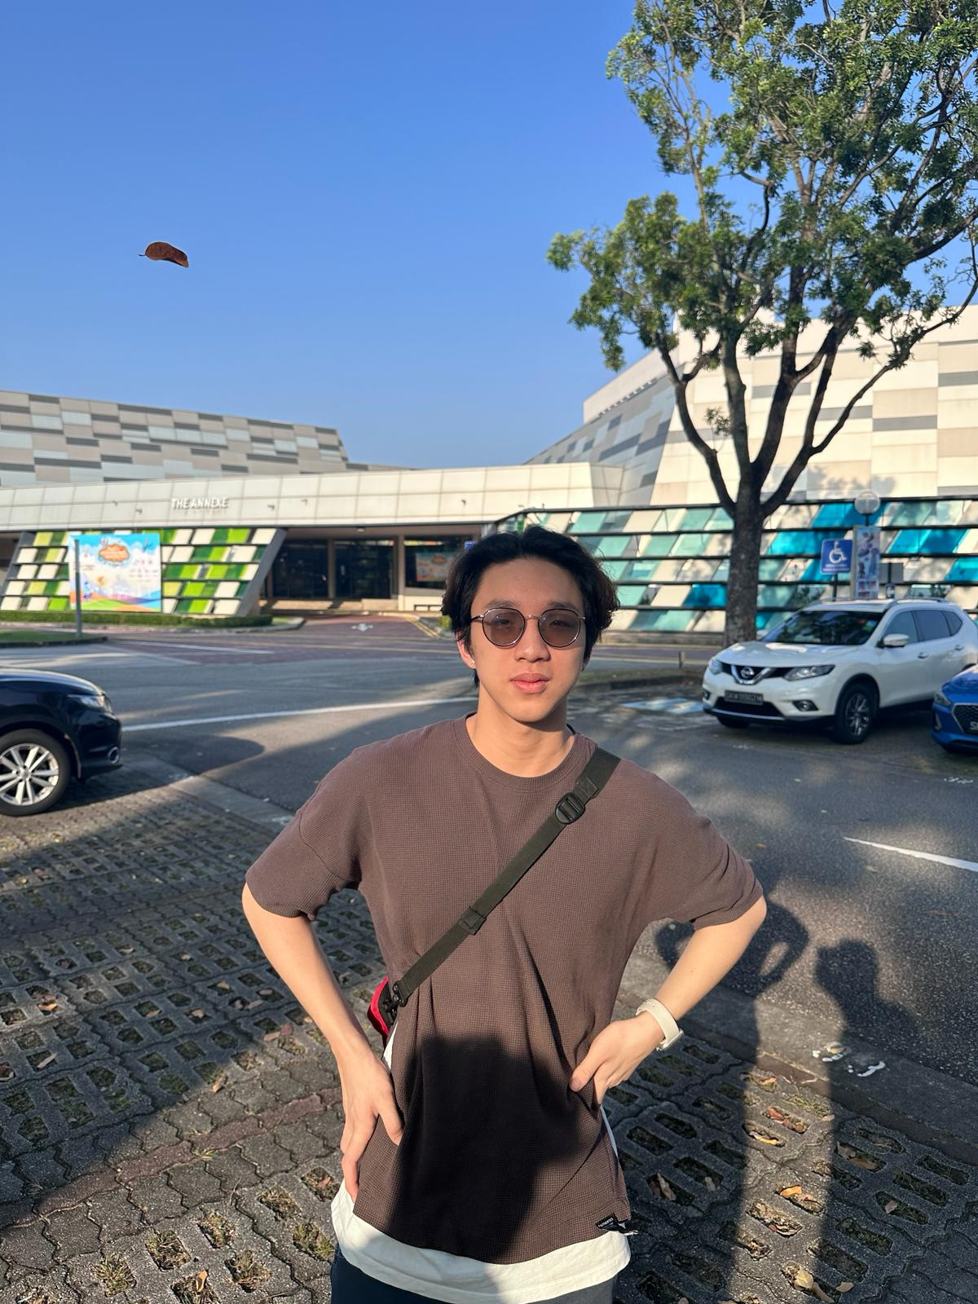
01 · Introduction
Team DOTA7, NYP
Sanjeev
Armando
Lynuz
Ashween
General
Commander
Camera Specialist
Design & Media Specialist
Rishi
Aldrin
Pierce
Hardware Specialist
Logistics Specialist
HR Specialist
Team DOTA7, NYP
3

Slide 4
Hardware
02
The Sensor Suite
Design Rationale
Team DOTA7, NYP
4

Slide 5
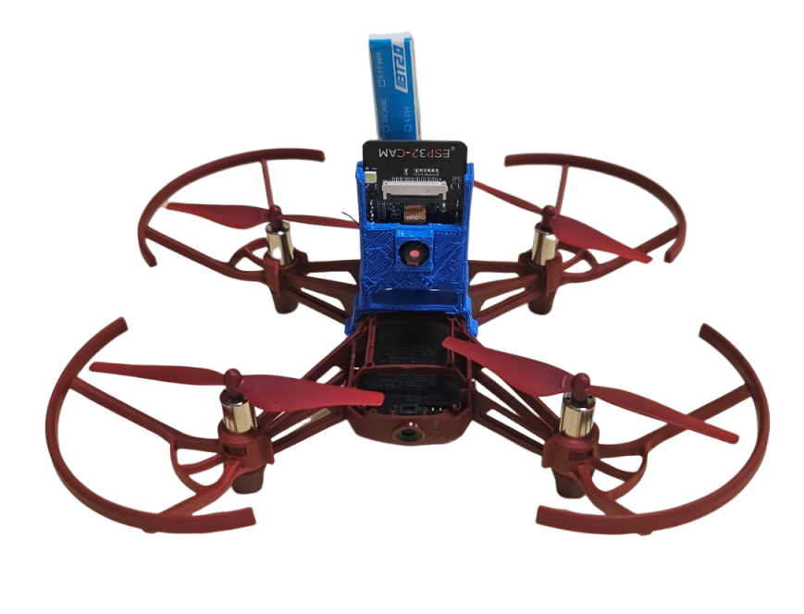
02 · Hardware
The Sensor Suite
Each drone is equipped with a:
Drone to hover in place
Fly indoors more precisely
Aids with obstacle avoidance, localisation & victim detection.
Our Drone
Team DOTA7, NYP
5
Camera
Infrared Sensor
Inertial Measurement Unit(IMU)
ESP32-CAM

Slide 6
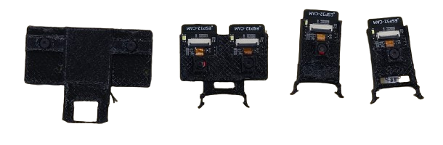
02 · Hardware
Design Rationale
Factors we considered as we iterated on our design:
Final mount!
Evolution of our ESP32-CAM mount
Team DOTA7, NYP
6
Weight
Temperature
Battery life

Slide 7
Software
03
Localisation Process
Obstacle Avoidance
The A* Algorithm
Team DOTA7, NYP
7

Slide 8
03 · Software
The Localization Process
3-Step Localization Process
01
02
03
Inertial Measurement Units (IMU)
Radio Signal Strength Indicators (RSSI)
Visual Localization
Team DOTA7, NYP
8

Slide 9
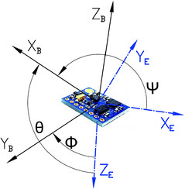
03 · Software
3-Step Localization Process
Inertial Measurement Unit
01
Using the IMU:
02
03
Team DOTA7, NYP
9
Sensor fusion to calculate the yaw, pitch and roll angle
Double integration to calculate distance
Measure the distance moved in the x-axis and y-axis

Slide 10

03 · Software
3-Step Localization Process
RSSI Localization
01
Why use BLE (Bluetooth Low Energy) for RSSI localization?
02
03
Bluetooth Low Energy
Team DOTA7, NYP
10
Wi-Fi RSSI is very noisy and easily affected by environmental factors
GPS does not work indoors and has too much error (about 1-5 km)

Slide 11
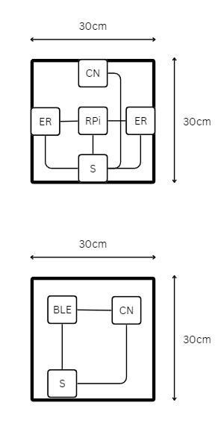
03 · Software
3-Step Localization Process
RSSI Localization
01
To assist our localisation:
02
Localization Server
03
Base Stations
Team DOTA7, NYP
11
Created a few nodes & bases
Base station consists of an ESP32-WROOM emitting BLE signals
Calibration node to calculate environmental constants and other components
Consists of 3 ESP32-CAMs receiving RSSI signals from the drone

Slide 12
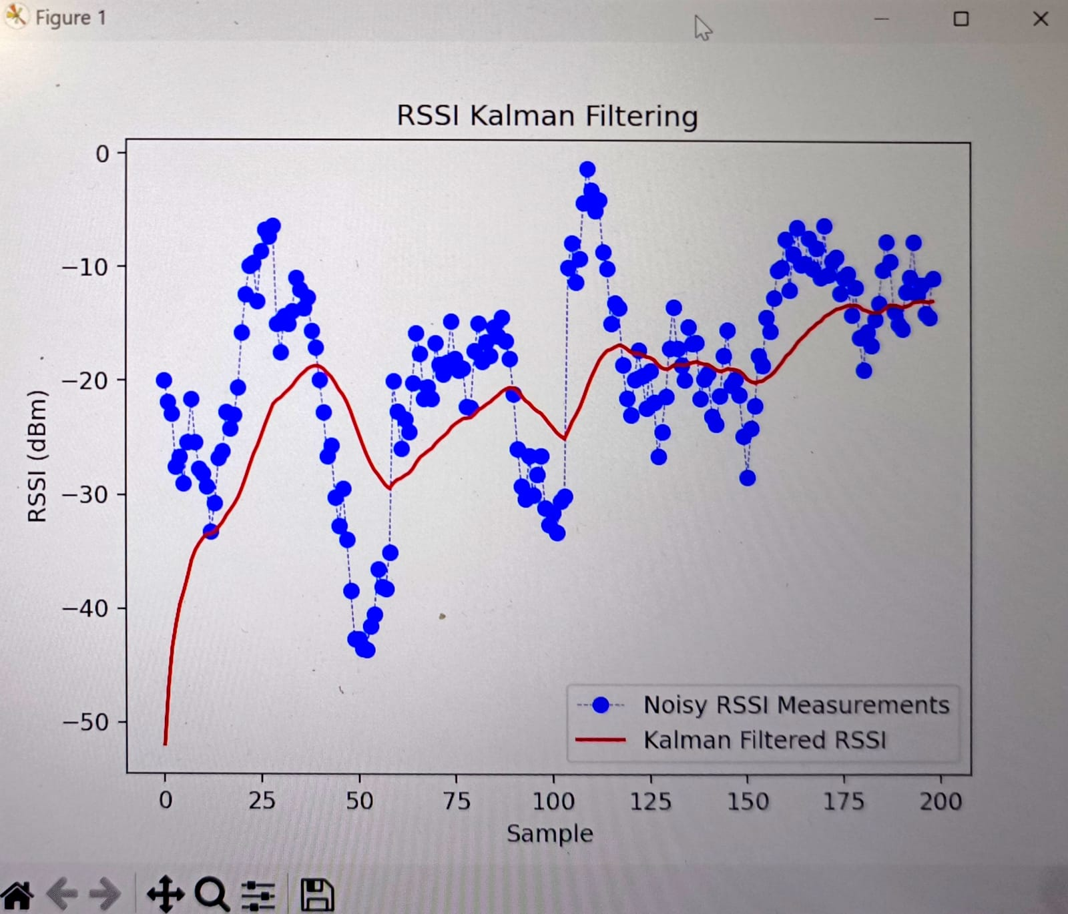
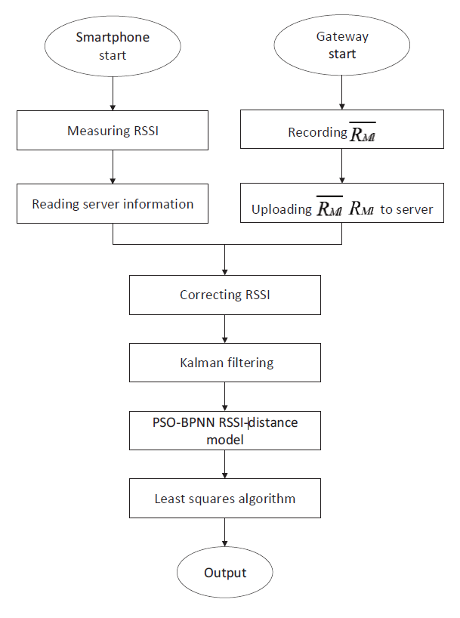
03 · Software
3-Step Localization Process
RSSI Localization
Kalman Filtering
01
Finally, the localization process:
02
03
Localization Process
Team DOTA7, NYP
12
Signals are connected to a Raspberry Pi 5, which runs an RSSI correcting algorithm
Next, through a Kalman filter and is fed into our artificial neural network
Backpropagation optimized with a particle swarm algorithm to give us the final distance

Slide 13
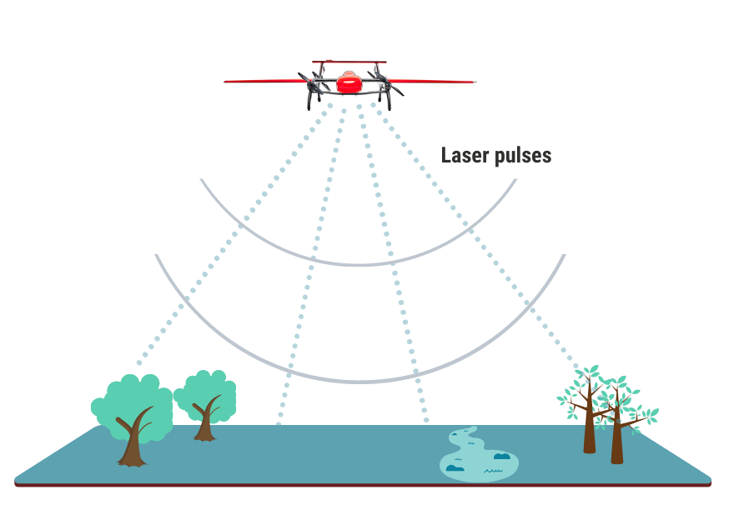

03 · Software
3-Step Localization Process
Visual Localization
Light Detection and Ranging
01
Laser Pulses
Before the drone begins taking pictures:
02
03
Team DOTA7, NYP
13
3D mesh render of the arena will be taken with LIDAR
Using Open3D, a virtual camera creates a 8 images of each coordinate point in the arena

Slide 14
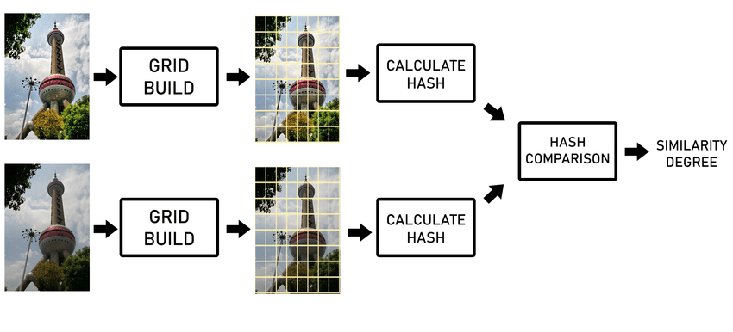
03 · Software
3-Step Localization Process
Perceptual Hashing
Visual Localization
Real Image
Virtual Image
01
Build Grid
Before the drone begins taking pictures:
02
Calculate Hash
03
Hash Comparison
Similarity Degree
Team DOTA7, NYP
14
3D mesh render of the arena will be taken with LIDAR
Using Open3D, a virtual camera creates a 8 images of each coordinate point in the arena
Using perceptual hashing, both images’ coordinate points are compared to determine the accurate location of the drone
Once determined, the real-life image replaces of the coordinate point of the virtual images

Slide 15
03 · Software
3-Step Localization Process
Visual Localization
01
3 different localization modes in the Visual Localization:
02
03
Team DOTA7, NYP
15
Left-Right
Front-Back
360 Degree Localization

Slide 16
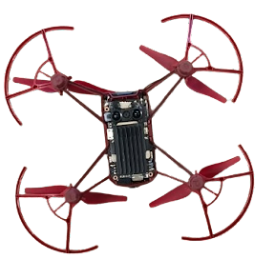
03 · Software
3-Step Localization Process
Rotates 45°, facing left, right and front
Visual Localization
01
3 different localization modes in the Visual Localization:
02
03
Takes 3 photos, 1 at each orientation
Team DOTA7, NYP
16
Left-Right
Front-Back
360° Localization

Slide 17
03 · Software
3-Step Localization Process
Rotates 180°, facing back and front
Visual Localization
01
3 different localization modes in the Visual Localization:
02
03
Takes 2 photos, 1 at each orientation
Team DOTA7, NYP
17
Left-Right
Front-Back
360° Localization

Slide 18
03 · Software
3-Step Localization Process
Rotates 360°, stopping at 45° intervals
Visual Localization
01
3 different localization modes in the Visual Localization:
02
03
Takes 8 photos, 1 at each orientation
Team DOTA7, NYP
18
Left-Right
Front-Back
360° Localization

Slide 19

03 · Software
Obstacle Avoidance
Depth Map
Team DOTA7, NYP
19
The drone takes an image of its surroundings
Calculates the estimate depth of the obstacles around it using Zoe depth monocular depth estimation, an Artificial Intelligence model
The AI takes the image, divides it into 3x3 sections and checks the average depth and proximity of each section
1 central server laptop is used to control 4 drones that divides the computational load allowing them to be run simultaneously

Slide 20
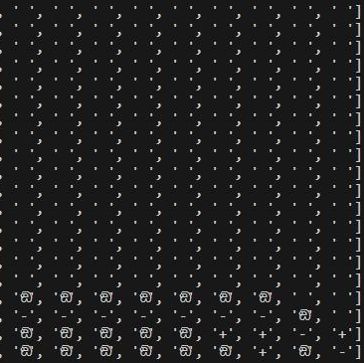
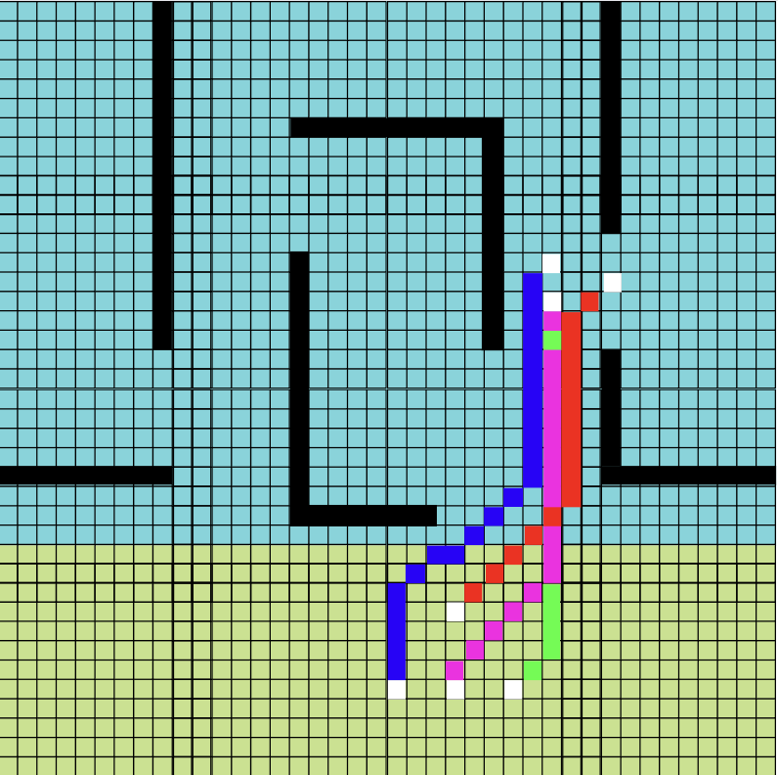
03 · Software
The A* Algorithm
A pathfinding algorithm
Find the shortest or most efficient route
A star algorithm uses open set and close set
Open set to explore
Close set not explore
Prototype Code Output
Final Code Output
Team DOTA7, NYP
21

Slide 21
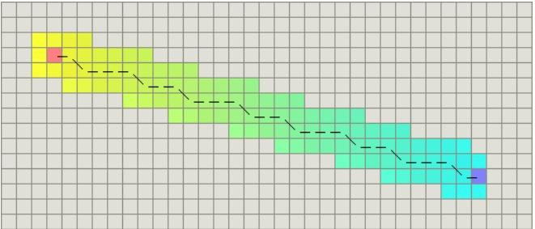
03 · Software
The A* Algorithm
Combines a cost function that measures the actual path cost (g(n)) with a heuristic function (h(n)) that estimates the remaining cost to the goal. This combination guides the algorithm efficiently.
Heuristics
Team DOTA7, NYP
20
A pathfinding algorithm
Find the shortest or most efficient route

Slide 22
Mission Plan
04
Search Strategy
Robust Intelligent Swarm Control
Other Strategies
Challenges & Lessons
Team DOTA7, NYP
23

Slide 23
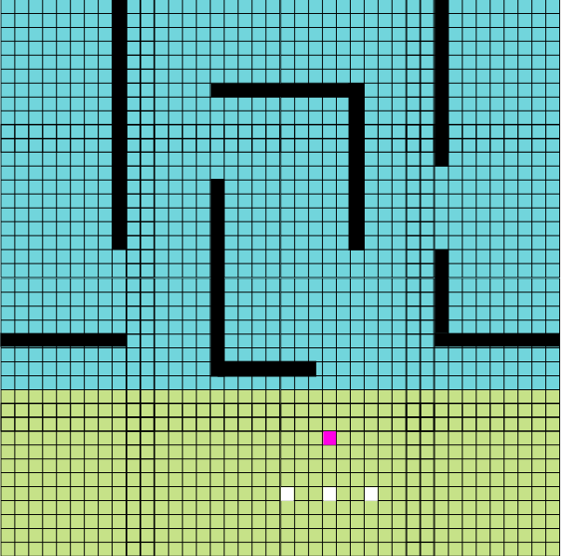
04 · Mission Plan
Search Strategy
Color Coordinated Victims in the Server
01
02
The Mission Map
Team DOTA7, NYP
24
Double Rescue
Single Rescue
Divided the map into 4 sectors
1 scout drone from each group of drones

Slide 24
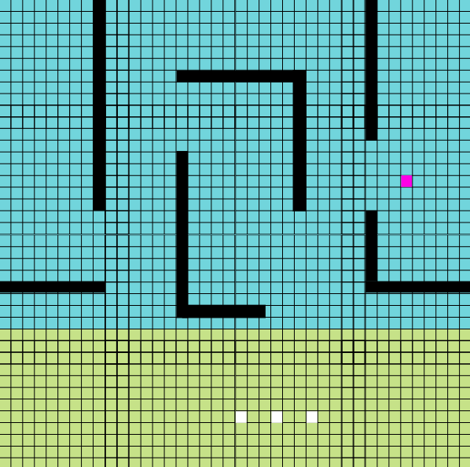
04 · Mission Plan
Search Strategy
03
04
The Mission Map
Team DOTA7, NYP
25
Localising and confirming that the drone is in the room, it descends and looks for the victims
It calculates the distance to the victim and the drone’s orientation using the magnetometer. With Trigonometry, the victim coordinates are calculated & relayed to the server, to ascertain its status

Slide 25
04 · Mission Plan
Search Strategy
05
06
The Mission Map
Team DOTA7, NYP
26
If victim status is “unknown”, the status is updated to “found - drones required”
A rescue drone informs the server that it is on the way
If it is a double rescue victim, the server ensures another drone is routed to the victim

Slide 26
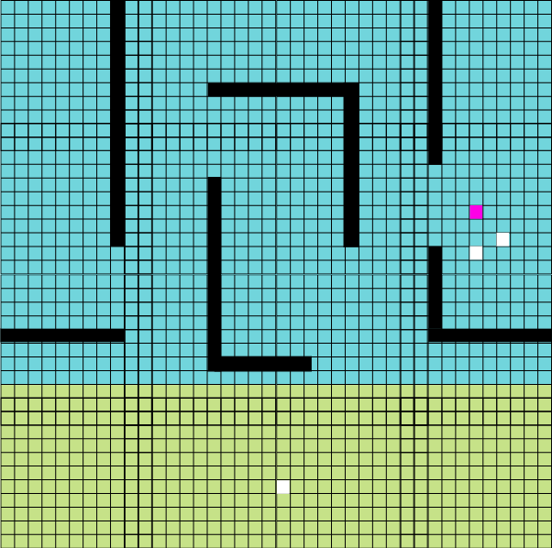
04 · Mission Plan
Search Strategy
07
08
The Mission Map
Team DOTA7, NYP
27
At the victim, the rescue drone localises before landing and updating the server on the relevant status of the victim
Until the victim’s status is NOT “found - drones required”, the server checks for assigned drones to the victim. Otherwise, the search continues!

Slide 27
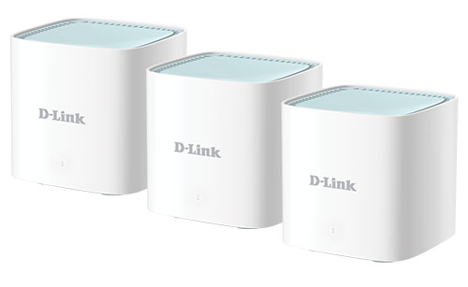
04 · Mission Plan
Robust Intelligent Swarm Control
Greatly reduced computational power
To communicate with all the drones simultaneously
Improve the latency and reduces data loss
Routers
Team DOTA7, NYP
28
Four laptops to run 16 drones
Another laptop as a centralized server
Specifically chosen for its beam forming technology and it AI traffic optimiser

Slide 28
04 · Mission Plan
Reducing Mission Time
Parallel processing
Team DOTA7, NYP
29
Leveraging multiprocessing and multithreading to run localization
IMU data processing and obstacle avoidance concurrently
Optimized pathfinding using A* algorithm uses more time-intensive localizations less frequently
Efficient data handling
Faster decision making
Balance precision with speed

Slide 29
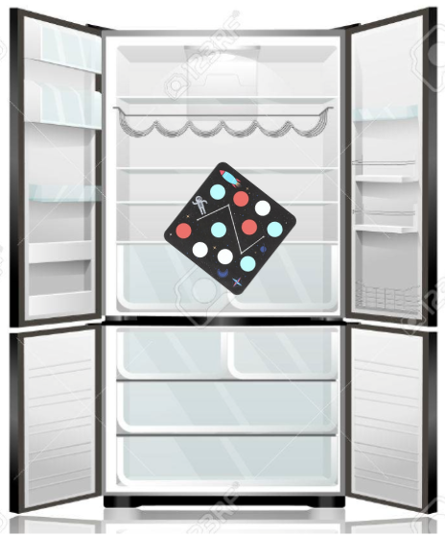
04 · Mission Plan
Other Strategies
Using a LiDAR camera:
Chilling the mission pads
Team DOTA7, NYP
30
Scan rooms in advance to acquire environmental data
SLAM system to construct a detailed virtual model for A* pathfinding
Chilling the mission pads used at takeoff points

Slide 30
04 · Mission Plan
Challenges & Lessons
Challenges Faced
Lessons Learnt
Team DOTA7, NYP
31
Technical hurdles
Design optimizations
Pre-scanning environments with LIDAR
Chilled mission pads for drone cooling

Slide 31
:)
Thank you!
Final Presentation | CAT E | Team DOTA7, NYP
Team DOTA7, NYP
32

Slide 32
`

Slide 33



02

Slide 34
oooooooooooooooooooooooawwawa
intro -> hardware -> software -> mission plan -> conclusion

Slide 35
Presentation Outline
01
03
02
04
Team DOTA7, NYP
2
Introduction
Software
Hardware
Mission Plan

Slide 36
01 · Introduction
Team DOTA7, NYP
Sanjeev
Team Lead
Team DOTA7, NYP
2
team pic here

Slide 37
03 · Software
wtf is this??? I also dont know what the hella heck this is but i tried splitting it up
thank you
Obstacle Avoidance
How does it avoid the obstacles:
Team DOTA7, NYP
10
Take 1 image run two process 1 is depth Est for obstacle avoidance using Zoe depth monocular depth estimation it is a ai model to detect the depth of the image using the depth value you can make minor adjustments to its path trajectory to best avoid the obstacles
The ai produces a depth image after which we divided it into a 3 x 3 sectors where we take the average depth value of each sector and check it against the proximity limit whichever sectors are equal to or more than the proximity limit determines the direction and magnitude of the correction.
Robust and intelligent methods of swarm control- divide and concore 1 laptop controls 4 drones to divide the computational load and run them simultaneously when we have a central server laptop
It takes an image of its surroundings and calculates the estimate depth of the obstacles around it using Zoe depth monocular depth estimation an ai model
The AI takes the image, divides it into 3x3 sections and checks the average depth and proximity of each section
1 central server laptop is used to control 4 drones that divides the computational load allowing them to be run simultaneously

Slide 38
01
Introduction
The Team
Chapter 1
Team DOTA7, NYP
1

Slide 39
02
Hardware
The Sensor Suite
Chapter 2
Design Rationale
Team DOTA7, NYP

Slide 40
03
Software
Localisation Process
Chapter 3
Inertial Measurement Unit
RSSI Localization
Simultaneous Localization & Mapping
Obstacle Avoidance
The A* Algorithm
Team DOTA7, NYP
5

Slide 41
04
Mission Plan
Search Strategy
Chapter 4
Robust Intelligent Swarm Control
Other Strategies
Challenges & Lessons
Team DOTA7, NYP

Slide 42
Thank You!
Final Presentation | CAT E
Team DOTA7, NYP

Slide 43

Mission Plan
04
Search Strategy
Robust Intelligent Swarm Control
Other Strategies
Challenges & Lessons
Team DOTA7, NYP

Slide 44










